Slide 1
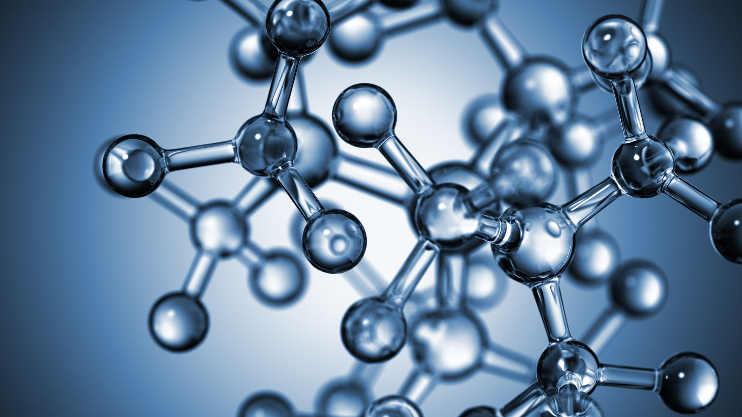


Chemical equilibrium. Factors influencing changes in the balance.
Al-Farabi Kazakh National University
Faculty of Chemistry and Chemical technology
Department of General and Inorganic Chemistry
pHd Bakhadur askar

Slide 2

The concept of chemical equilibrium
Chemical equilibrium occurs in a reversible reaction when the rates of the forward and reverse reactions become equal.
At equilibrium, the concentrations of reactants and products remain constant, although both reactions continue to occur.
In this state, the system reaches dynamic balance, not a static halt — molecules continuously react but with no net change in composition.
$$A+B⇌C+D$$

Slide 3
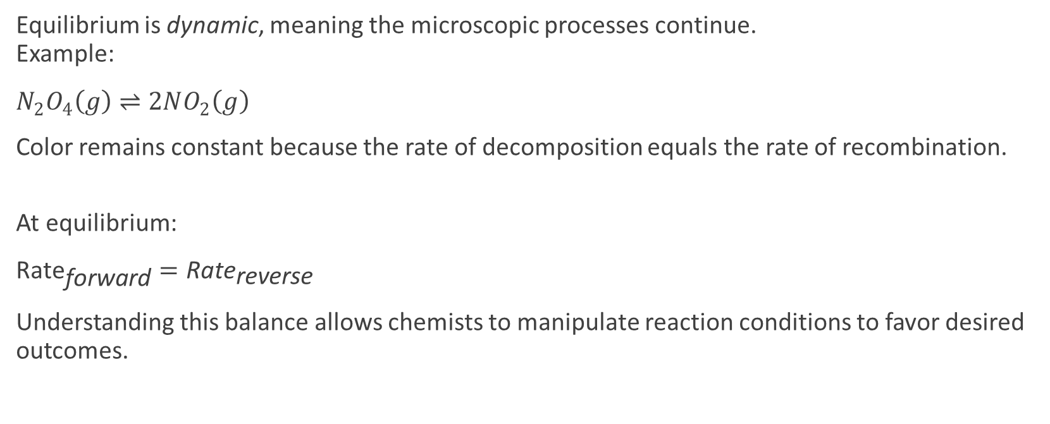
Dynamic nature of equilibrium
Equilibrium is dynamic, meaning the microscopic processes continue.
Example:
$N_{2}O_{4}\left(g\right)⇌2NO_{2}\left(g\right)$
Color remains constant because the rate of decomposition equals the rate of recombination.
At equilibrium:
${\text{Rate}}_{\text{forward}}={\text{Rate}}_{\text{reverse}}$
Understanding this balance allows chemists to manipulate reaction conditions to favor desired outcomes.

Slide 4
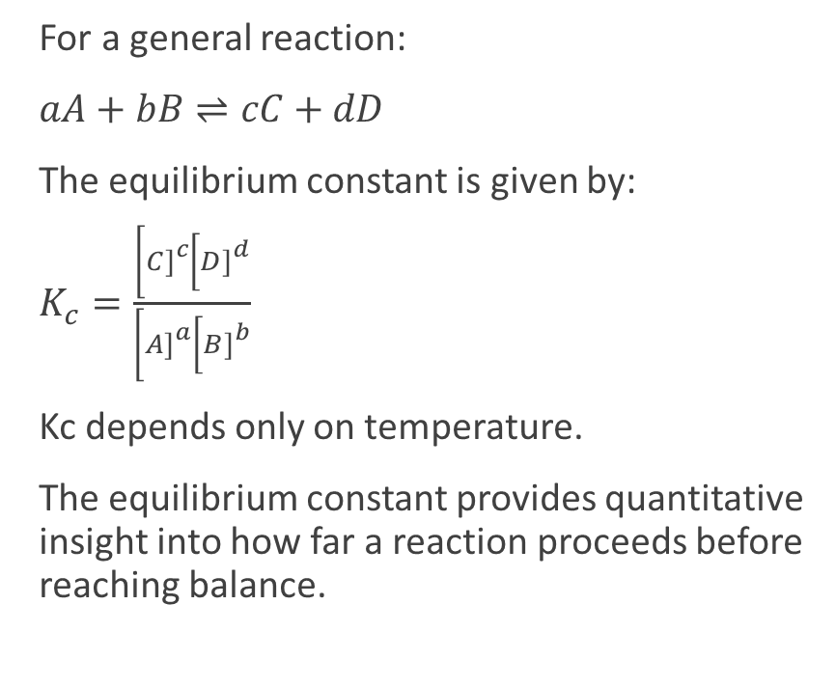
The equilibrium constant (K)
For a general reaction:
$aA+bB⇌cC+dD$
The equilibrium constant is given by:
$K_{c}=\frac{\left[C{\left.]\right.}^{c}\left[D{\left.]\right.}^{d}\right.\right.}{\left[A{\left.]\right.}^{a}\left[B{\left.]\right.}^{b}\right.\right.}$
Kc depends only on temperature.
The equilibrium constant provides quantitative insight into how far a reaction proceeds before reaching balance.
A large K (>1) indicates products are favored.
A small K (<1) means reactants are favored.

Slide 5
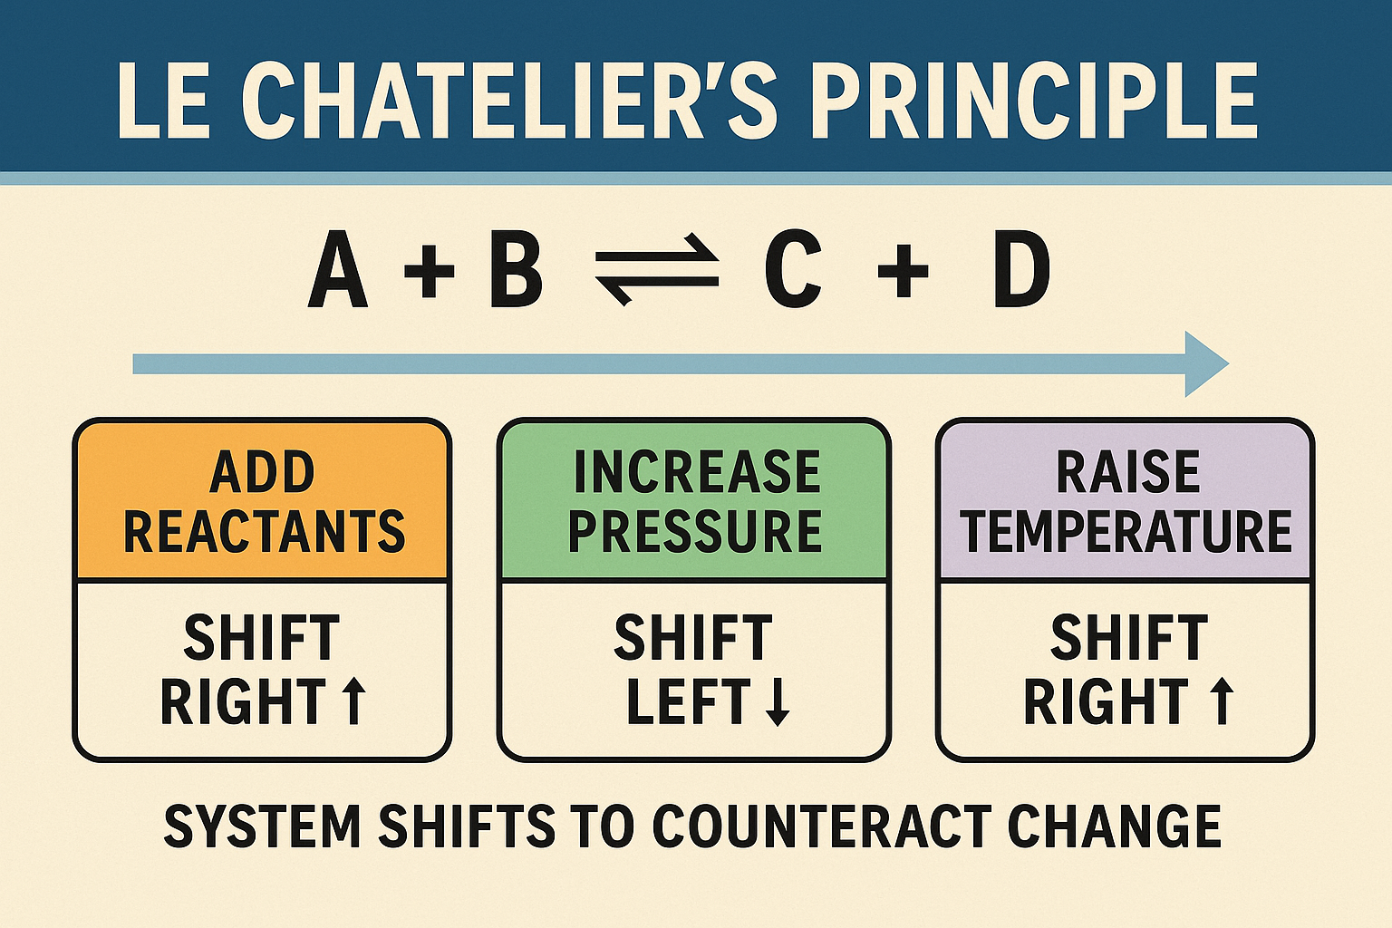
Le Châtelier’s principle
Le Châtelier’s Principle states that if a system at equilibrium is disturbed, it will shift in the direction that counteracts the disturbance.
Possible disturbances include changes in:
Concentration
Temperature
Pressure (for gases)
Volume
This principle allows chemists to predict how equilibrium adjusts and to control yields in industrial and laboratory processes.

Slide 6
Effects of various factors
1. Concentration:
Adding reactants shifts equilibrium right (toward products).
Removing products also shifts equilibrium right.
2. Temperature:
Endothermic reactions shift right with increased temperature.
Exothermic reactions shift left when heated.
3. Pressure/Volume:
Increasing pressure shifts equilibrium toward the side with fewer gas molecules.
4. Catalysts:
Do not change equilibrium position; only affect rate of attainment.

Slide 7

Quantitative expressions and temperature dependence
The Van’t Hoff equation describes the temperature dependence of the equilibrium constant:
This relationship helps predict how equilibrium shifts with thermal changes and is essential in thermodynamic and kinetic control of reactions.
If ΔH° > 0 (endothermic), K increases with temperature.
If ΔH° < 0 (exothermic), K decreases with temperature.
$$\frac{d\left(\ln{K}\right)}{dT}=\frac{ΔH°}{RT^{2}}$$

Slide 8
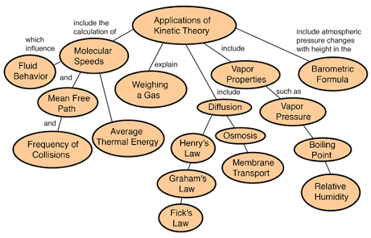
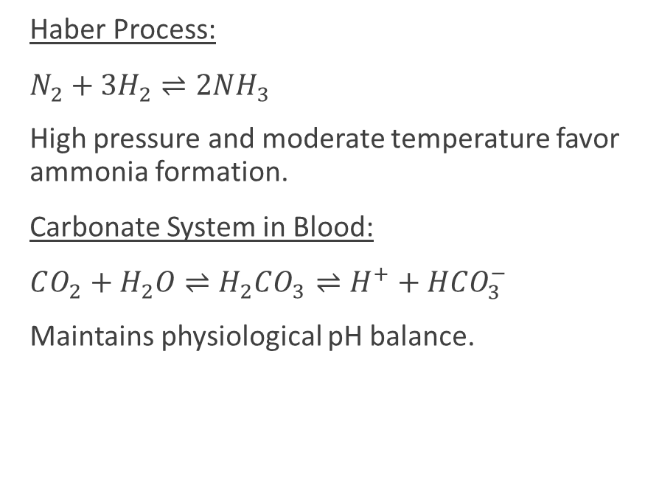
Applications
Haber Process:
$N_{2}+3H_{2}⇌2NH_{3}$
High pressure and moderate temperature favor ammonia formation.
Carbonate System in Blood:
$CO_{2}+H_{2}O⇌H_{2}CO_{3}⇌H^{+}+HCO_{3}^{−}$
Maintains physiological pH balance.

Slide 9
Summary
Chemical equilibrium is a dynamic and controllable state governed by thermodynamic and kinetic factors.
By understanding equilibrium constants and Le Châtelier’s Principle, scientists can predict, manipulate, and optimize chemical processes in both industry and biology.

Slide 10

Questions?

